Slide 1
Tarpon Springs High School
Quarter 1 Student Expectations and Student Guidelines for Success on Campus

Slide 2
Mrs. Leza Fatolitis
School Principal
12th Grade: (9th grade: A - G )
Lisa Lennox
11TH Grade: (9th grade: O - Z )
Michael Mellinger
10th Grade: (9th grade: H - N )
Martin Guevara

Slide 3
School Counselors
SENIORS Last Name A – G
Sharon Savino - savinos@pcsb.org – 9th
SENIORS Last Name H – N
Irene Pantelis - pantelisi@pcsb.org – 10th
Assistant Principal – Martin Guevara
SENIORS Last Name O - Z
Alyssa Cerge – cergea@pcsb.org – 11th
Assistant Principal – Michael Mellinger

Slide 4
TSHS EXPECTATIONS
Respect
Responsibility
Resiliency

Slide 6
TSHS EXPECTATIONS
Arrive every day with open mind
Be in class ready to learn before the bell rings
Dress Code – follow the student code of conduct rules for dress code

Slide 7
RESTROOMS
Are the restrooms on campus clean, safe and orderly? Please scan to share your feedback so we can make it right!

Slide 9
TSHS Expectations
Progressive Discipline
Positive Reinforcement

Slide 10
Tardies
Teachers will record your tardies based on their classroom procedures.
Consequences will be given on a weekly basis for tardies.
*Alerts will be sent to your parents or guardians for each tardy you receive
Number of Tardies per Week | Consequence
1-2 | Tardy Warning Messages
3 - 6 | Lunch Detention Meeting with Behavior Specialist
7 - 9 | Administrative Referral In School Suspension
Students who are continuously tardy on a weekly basis will be put on a success plan

Slide 11
Dress Code
A. All shirts and blouses must cover midriff, back, sides, and all undergarments including bra straps at all times. All shirts, tops, and dresses shall have sleeves and cover the shoulders.
B. Shorts, skirts, divided skirts, dresses and culottes are allowed. They must be mid-thigh length or longer.
C. All trousers, pants, or shorts must totally cover undergarments, including boxer shorts.

Slide 12
Dress Code continued...
D. All clothing, jewelry, or tattoos shall be free of the following: profanity; violent images, wording or suggestion; sexually suggestive phrases or images; gang related symbols; alcohol, tobacco, drugs or advertisements for such products.
E. Safe and appropriate footwear must be worn. Inappropriate footwear includes, but is not limited to, roller skates, skate shoes, and bedroom slippers.
*If you are in violation of the dress code your parents or guardians will receive a phone call and email and you will be asked to remedy the violation. Failure to do so will lead to further consequences such as being sent home as an unexcused absence.

Slide 13
Hallway Expectations
You must ALWAYS:
-Have a pass
-Be prepared to present your pass
-Be moving towards your destination

Slide 14
Opening Gates
During the school day:
-Students should only enter the campus through the main office
You must NEVER:
-Allow students through gates on campus
-Give or receive anything by the fence
This is a serious safety concern and will result in consequences for both parties.

Slide 15
Lunch Room Expectations
- Wait in line for your lunch
- Maintain a flow of traffic around the registers and condiment areas
- Enjoy your lunch
- Clean up your area (table, floor, etc.)
-DoorDash and UberEats deliveries are not allowed
*Cutting in line, throwing food, or stealing will result in consequences including lunch detention, IC, or ABS

Slide 16
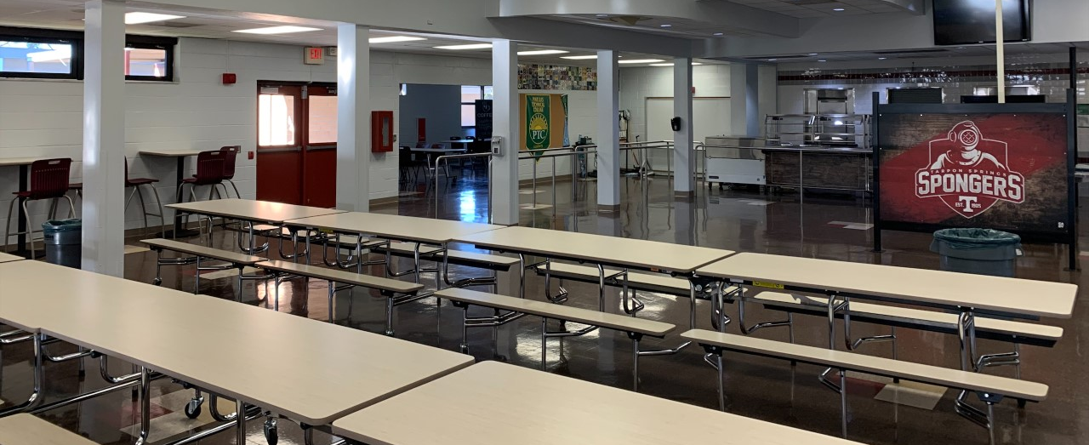
Lunch Detention
-You are to report the supervisor on duty in the room 4-003 for your attendance to be taken.
-You will be asked to be seated in the lunch detention area. You will wait here to be released to get lunch.
-You are to sit independently with no talking.
-Failure to report to lunch detention will lead to you receiving IC.

Slide 17
Intervention Center
-The Intervention Center is in the lunchroom in the back left of the cafeteria, where lunch detention is held
-IC is an academic area with computers, daily schoolwork is expected to be completed via Canvas or email
-Assigned IC must be completed; if a student is absent for day of IC, IC will be moved to the next day
-Discipline in IC will result in OSS

Slide 18
See Something Say Something
Presented by: Tarpon Springs High School SAVE Promise Club

